Slide 1

Azure Cloud Architect Nanodegree Amit Lathiya (Tutor)
Project 1 – Moving from On-Prem to the Azure Cloud

Slide 2
Agenda
Ice Breaker
Project Walkthrough
Rubrics Walkthrough
VPN Concepts (Points-to-Site Connection)
Questions

Slide 3
Ice Breaker Question
What technology innovation made the most impact on your life?

Slide 4
Project Walkthrough
Problem Statement
Contoso is an online cloth merchandise company specializing in selling activewear. They have rented space in a local data center. They have one system administrator who makes sure all servers are working properly 24x7. Their hardware is getting old and they must decide on whether they need to spend $22,000 for new hardware or move their business to the Azure cloud services.
On-premises infrastructure:
Server 1
Purpose: WordPress web server
CPU: 8 Cores and 60% average utilization
RAM: 16 GB and 87% average utilization
HDD OS: 500 GB capacity with 57 GB used
Web URL: Contoso.com
IP # Public: 200.200.100.50
IP #: 10.10.1.11
Firewall: Inbound TCP 2222-2224, 80, 443
Usage: This is Contoso’s only web server. It runs WordPress and eCommerce services. Their on-line store is always open, and they receive orders 24x7
This server uses ports 80 and 443 for HTTP and HTTPS traffic

Slide 5
Servers 2 & 3:
Purpose: Microsoft SQL 2019
CPU: 8 Cores and 30% average utilization x2
RAM: 16 GB and 87% average utilization x2
HDD OS: 500 GB capacity with 240 GB used x2
HDD Data: 2 TB SAN (Storage Area Network drive)
IP #: 10.10.1.12 and 10.10.1.13
SQL Cluster: SQLCluster.Contoso.Com
IP #: 10.10.1.14
Firewall: Inbound TCP 2222-2224, 1433
Usage: These two servers are running Microsoft SQL cluster services. SQL Always-On service is fully configured as Active-Passive nodes. The 2 servers use an external attached SAN drive for all data storage such as product descriptions, transaction logs, and clients lists. Annual data growth is negligible.
These servers use the standard SQL inbound TCP port 1433
Server 4:
Purpose: ABC Backup and Restore server
CPU: 8 Cores and 30% average utilization
RAM: 16 GB and 87% average utilization
HDD OS: 500 GB capacity with 164 GB used
HDD Backup: 40 TB
IP #: 10.10.1.15
Firewall: Inbound TCP 2222
Usage: The ABS backup software runs daily at 8pm. It stores the last 18 months of all the SQL data drive contents onto a local D: drive (HDD Backup) with 40 TB capacity.

Slide 6
Server 5:
Purpose: XYZ Antivirus server
CPU: 8 Cores and 30% average utilization
RAM: 16 GB and 87% average utilization
HDD: 500 GB capacity with 43 GB used
IP #: 10.10.1.16
Firewall: Inbound TCP 2222-2224
This server uses ports TCP 2222-2224 for the antivirus client
Usage: The XYZ anti-virus services are essential for the security of Contoso’s operations security. The server is always on and constantly running. It monitors all Contoso’s servers and mitigates against viruses and hack attacks. Data grown is negligible.
Project Instructions
Step 1: Assessing the On-Premises Environment
List the current on-premises environment
Match the on-premises environment to Azure solutions
Answer two discussion questions on how to find services and firewall exceptions (Windows OS)

Slide 7
Step 2: Monthly Cost Estimates
Create a table analyzing the monthly costs of your chosen Azure solutions
Answer two discussion questions on high availability/disaster recovery and the ability to change VM types (and include a screenshot of a VM change).
Note: If you are using Udacity Cloud Labs, you will be allowed to create a few VM sizes only. You need to click on "See all sizes" after visiting this link to see all possible VM sizes.
Step 3 (Optional): Set up a VPN
Create a VPN between your on-premises environment and Azure, in order to securely transfer assets. This may be very time-intensive, so note that it is quite all right to skip this step for this project!
Step 4: Deploy an Additional Server
Deploy an additional WordPress server (and include a screenshot of the template configuration process)
Answer two discussion questions on the benefits of ARM templates and differentiating between ARM templates and server images
Step 5: Backup and Recovery
Back up all VMs (and provide screenshots of the Backup Vault and Backup Policy)
Answer two discussion questions on Azure Backup vs. Site Recovery and RTO vs. RPO.
Step 6: Antivirus Communication
Adjust the network security groups for the servers to allow for communication between them and the antivirus server (and provide a screenshot of the modified nsg firewall inbound rules).
Answer a discussion question regarding inbound port exceptions.

Slide 8
Assessing the On-Premises Environment
CRITERIA | MEETS SPECIFICATIONS
Inventory the on-premises environment. | (Step 1) Includes a list of all current on-premises servers and services. Make sure to list any relevant backups or antivirus for each server.
Investigate equivalent Azure solutions to the on-premises environment. | (Step 1) Matches the list of on-premises servers and services to reasonable corresponding Azure ones.
Inventory relevant services and firewall exceptions to carry to the cloud. | (Step 1) Answers the two discussion questions for Step 1, regarding: inventorying services running on on-premises devices where any firewall exceptions can be found
Cost Estimates
CRITERIA | MEETS SPECIFICATIONS
Analyze cost estimates of the cloud migration. | (Step 2) Includes a table providing your current server farm and its corresponding Azure farm. Lists the potential Azure replacement for each of the on-premises servers, the VM type and monthly cost.
Assess the possibility of high availability / disaster recovery in the cloud. | (Step 2) Discusses any single points of failure or redundancy concerns with their current Azure plan. For example, what happens to availability if a server needs an upgrade?
Research scalability of deployed VMs. | (Step 2) Discusses whether or VM type / size can be changed after deployment. Includes a screenshot of the VM Overview settings, including at least the VM name and size.

Slide 9
Additional WordPress Server
CRITERIA | MEETS SPECIFICATIONS
Create a replica of the WordPress server configuration. | (Step 4) Creates a replica of the WordPress server configuration, and includes a screenshot of the template configuration process.
Perform a cost/benefit analysis of using ARM templates. | (Step 4) Lists at least three benefits of using ARM templates. Think of when, why and how you can benefit from this Azure service.
Compare and contrast ARM templates with server images. | (Step 4) Distinguishes between the ARM template and a server image, both in what they are and when they are used.
Backup and Recovery
CRITERIA | MEETS SPECIFICATIONS
Back up all cloud VMs. | (Step 5) Backs up all VMs, and provides a screenshot of the 1) backup vault and 2) the backup policy. The name of the backup vault should be present.
Compare and contrast Azure Backup and Azure Site Recovery. | (Step 5) Discusses the difference between Azure backup and site recovery, including when would you use each service and for what reason.
Compare and contrast Restore Time Objective (RTO) and Restore Point Objective (RPO). | (Step 5) Discusses the differences between Restore Time Objective (RTO) and Restore Point Objective (RPO).

Slide 10
Antivirus Communication
CRITERIA | MEETS SPECIFICATIONS
Adjust Network Security Groups to allow for traffic from the antivirus server. | (Step 6) Each Network Security Group (NSG) is adjusted to allow for traffic from the relevant antivirus server. Provides a screenshot of the modified NSG firewall inbound rules confirming that relevant ports/IP are open to traffic.
Analyze the need for an inbound port exception on Windows OS. | (Step 6) Discusses whether they need to create an inbound port exception on a Windows OS.

Slide 11
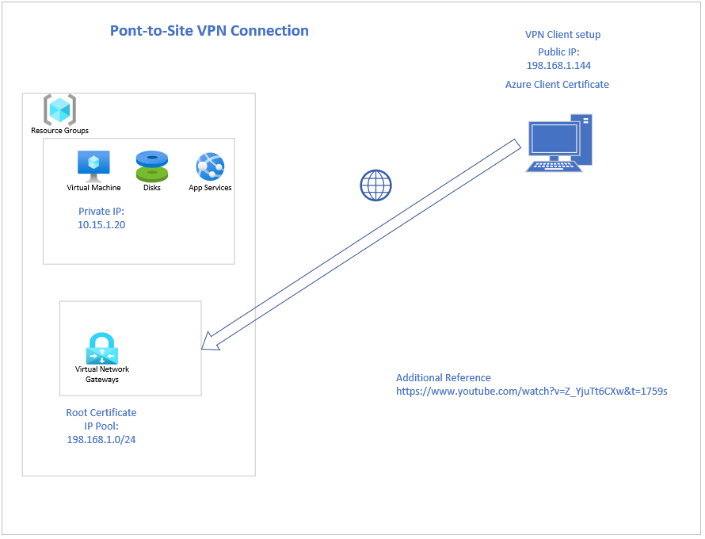

Slide 12
QUESTIONS

